Slide 1


CAPSTONE DESIGN 02 PRESENTATION
NETWOD
Team 14
Kim Jeonghoon 20146235
Min Sungjae 20145223
Go Sungju 20165245 (Presenter)

Slide 2
01 Weekly plan
02 Progress
INDEX
03 Problems & Solutions
04 Next week plan
Q & A

Slide 3
1 ”
Weekly plan

Slide 4

01
Weekly plan
Plan
02
03
 | 2nd | 3rd | 4th | 5th | 6th | M I D D E M O
Jeonghoon,Kim | Defining data structure for database | Basic android UI design& develop |  | Basic android app function design&develop | Integrating modules & Test
Sungjae,Min | Making excel sheet template& Data collection | Implementation of excel parsing module | Implementation of App database
Sungju,Go |  | WOD data collection& data store to data structure | Implementation of WOD generating module
 | 9th | 10th | 11th | 12th | 13th | F I N D E M O
Jeonghoon,Kim | Community android UI design& develop |  | Community android app function design & develop |  | Integrating modules& test
Sungjae,Min | Build community server system |  | DB system implementation & Build data transfer module
Sungju,Go | Implementation of statistical function
04

Slide 5
2”
Progress

Slide 6
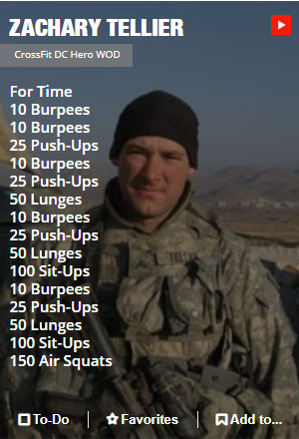
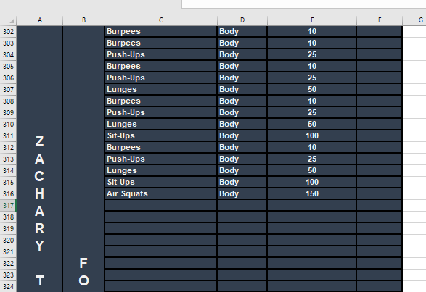
02
Progress
Progress
01
03
WOD data collection
Data store to data structure
04

Slide 7
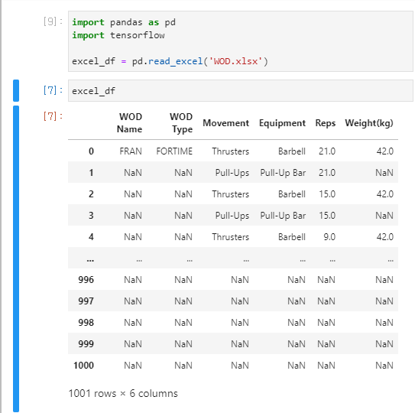
02
Progress
Progress
01
03
WOD data collection
Data store to data structure
04

Slide 8

02
Progress
Progress
01
03
WOD data collection
Data store to data structure
04

Slide 9
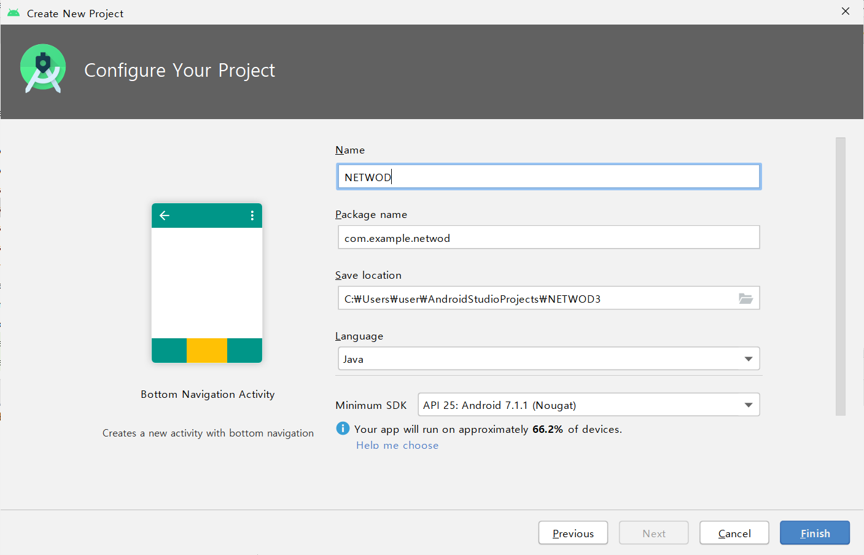
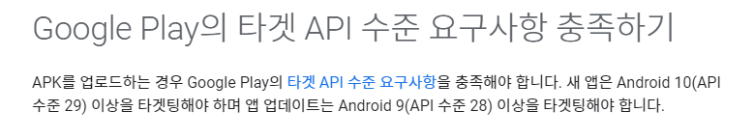
02
Progress
Progress
01
03
Basic android UI
Design & Develop
04
From November 2, 2020, app updates
require Android 10 (API level 29)
or higher.
Minimum SDK API 25

Slide 10
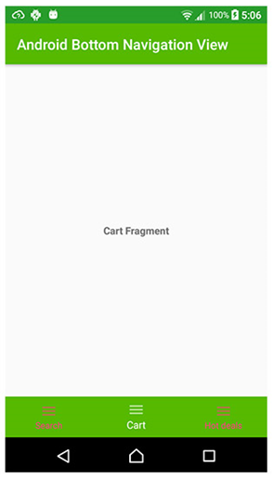
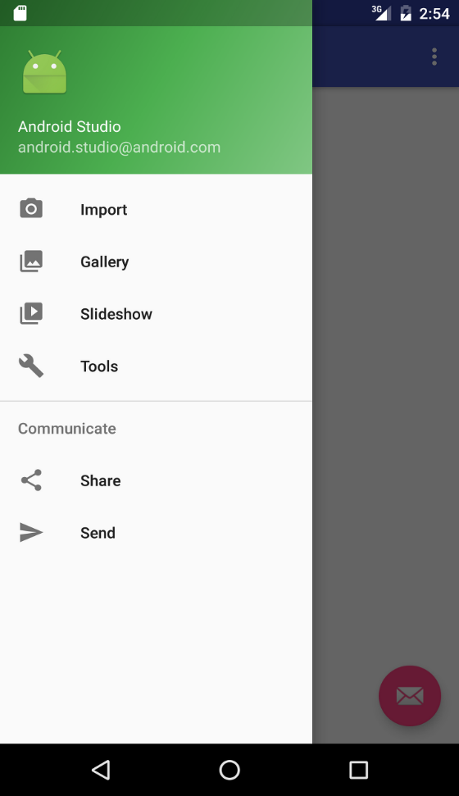
02
Progress
Progress
01
03
Basic android UI
Design & Develop
04
BottomNavigationView
More Suitable
NavigationView
BottomNavigationView

Slide 11
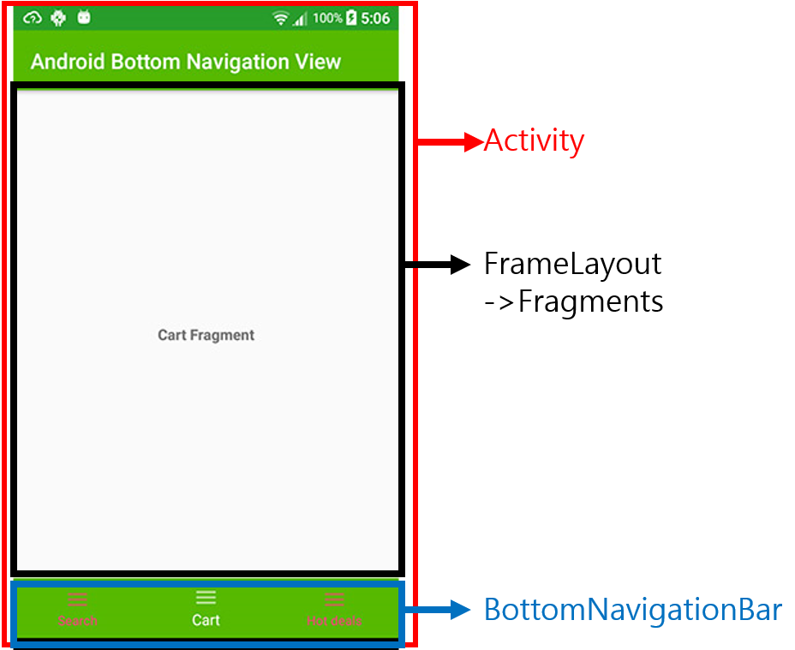
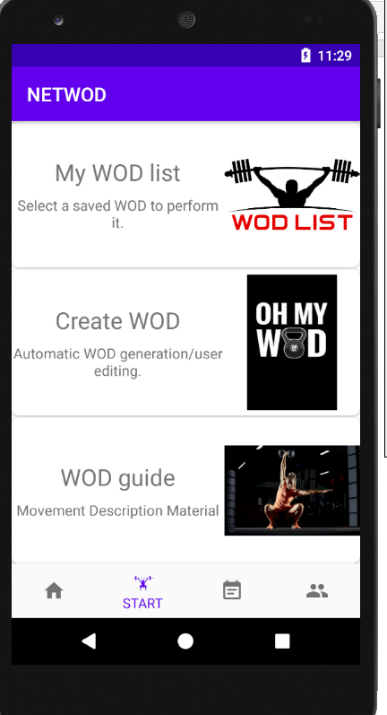
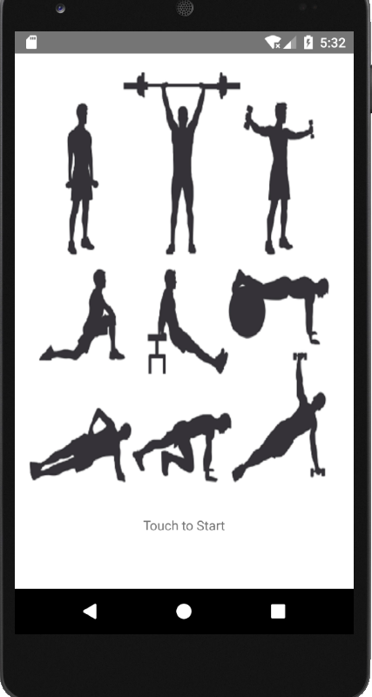
02
Progress
Progress
01
03
Basic android UI
Design & Develop
04
Splash screen
(loading screen)
Basic UI

Slide 12
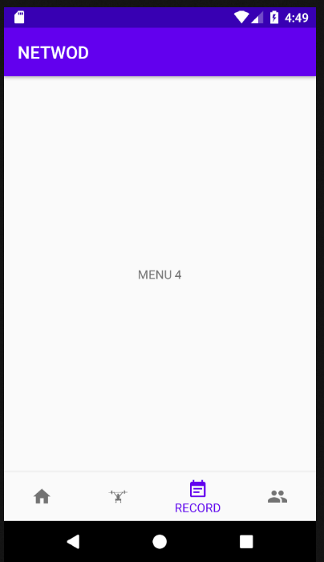
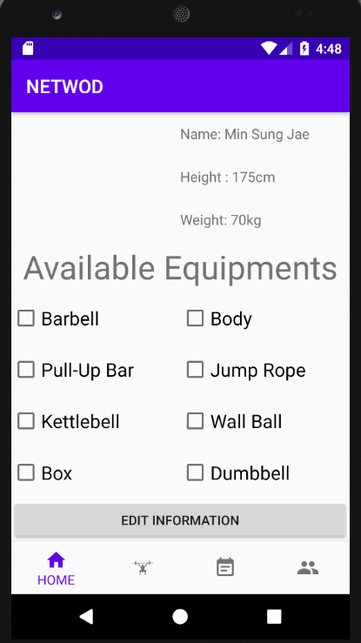
02
Progress
Progress
01
03
Basic android UI
Design & Develop
04
BottomNavigationBar Fragmants
Basic UI

Slide 13
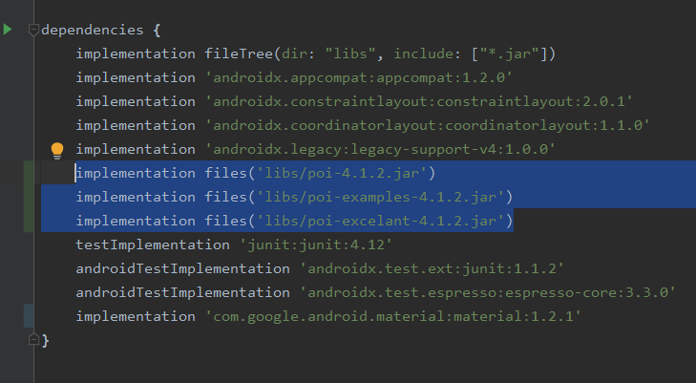
02
Progress
Progress
01
WOD linkage android
Implementation of excel parsing module
03
04
Apache POI library
Link jar/Android

Slide 14
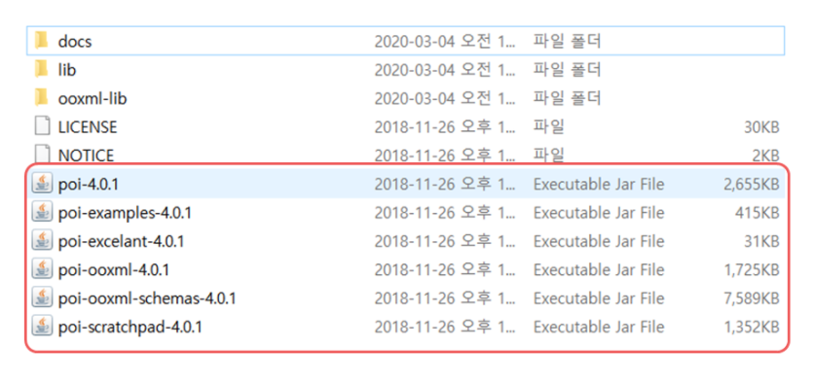
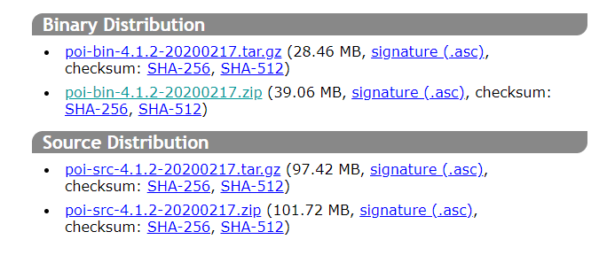
02
Progress
Progress
01
WOD linkage android
Implementation of excel parsing module
03
04
JAR Java Archive

Slide 15
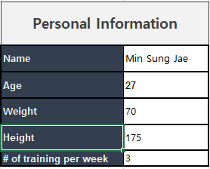
02
Progress
Progress
01
WOD linkage android
Implementation of excel parsing module
03
04

Slide 16
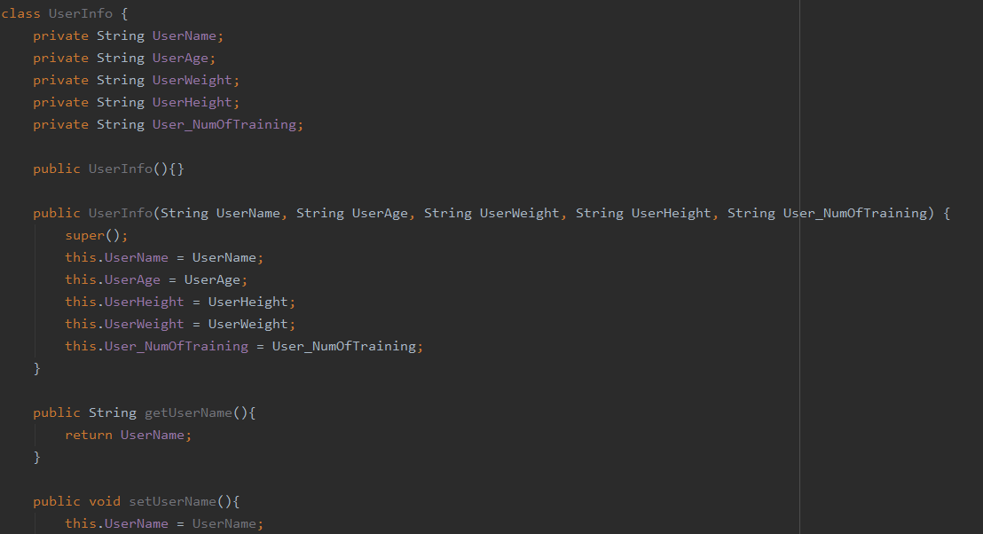
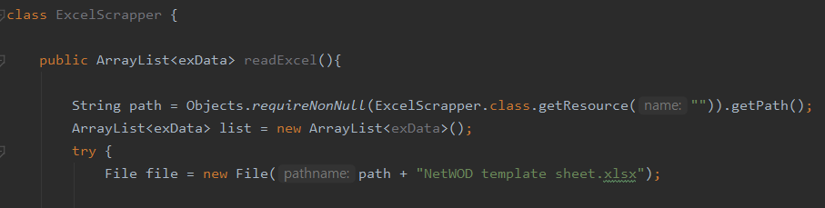
02
Progress
Progress
01
‘Get’, ‘set’ part
WOD linkage android
Implementation of excel parsing module
03
04
accessing the path part

Slide 17
3”
Problems & Solutions

Slide 18
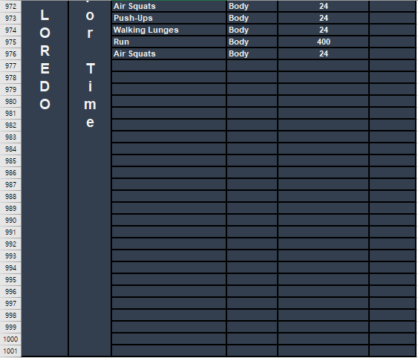
03
Problems
Progress
01
02
WOD data collection
WOD-list too Lack to learn(ML)
04
Only 20 kind of WOD

Slide 19
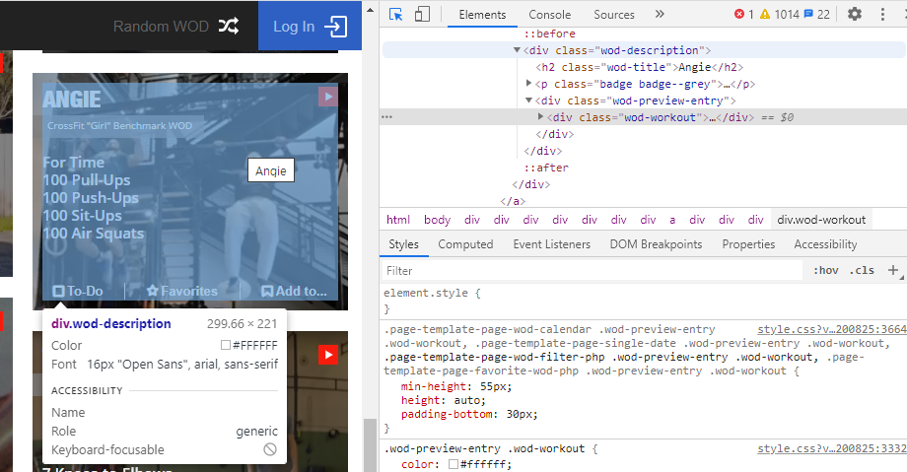
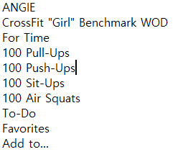
03
Solution
Progress
01
WOD data collection
WOD-list too Lack to lean(ML)
02
04
Web Crawling
Scraping
Scaling

Slide 20
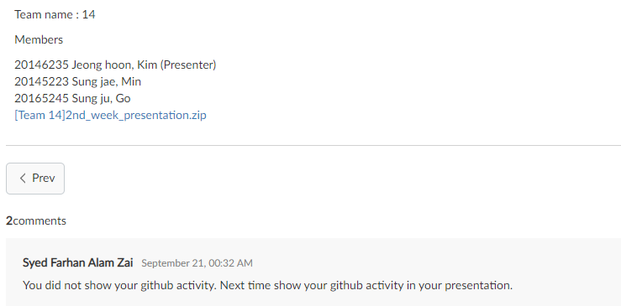
03
Problems
Progress
01
02
Github activity
In presentation
04

Slide 21
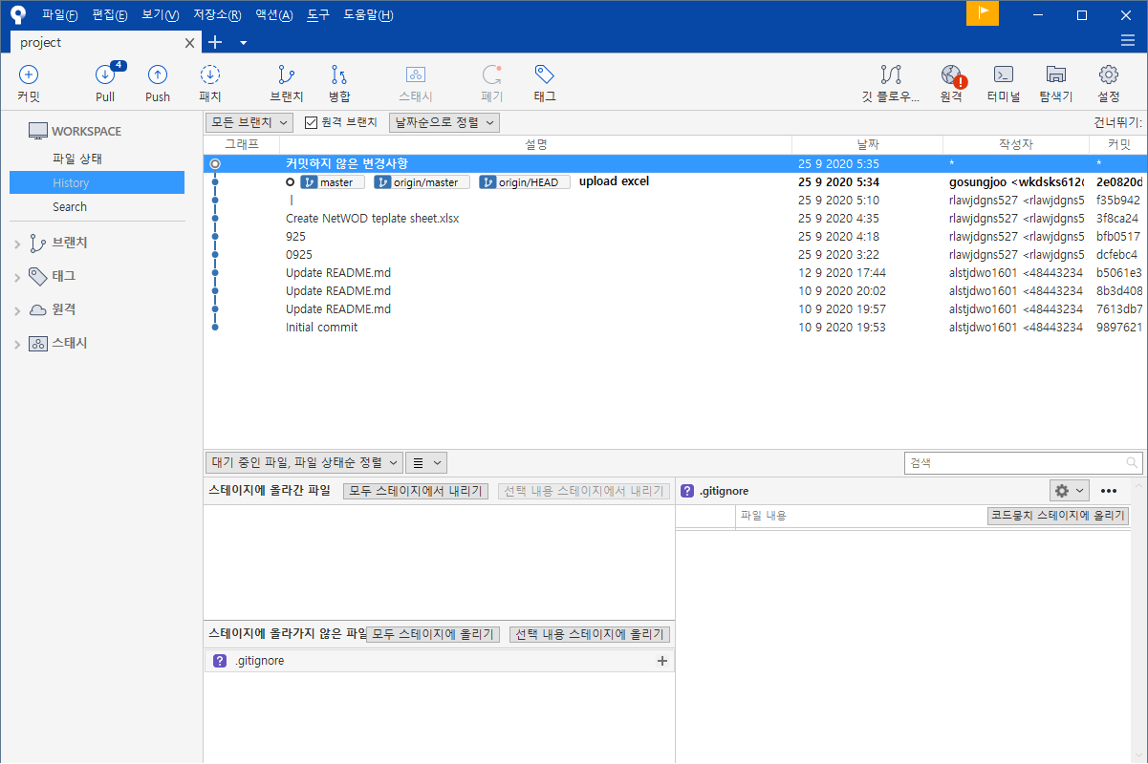
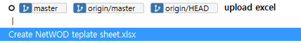

03
Solution
Progress
01
02
Github activity
In presentation
04
New data
file name or process name
Update
date

Slide 22
4”
Next week plan

Slide 23
04
Next
Next
01
02
 | 2nd | 3rd | 4th | 5th | 6th | M I D D E M O
Jeonghoon,Kim | Defining data structure for database | Basic android UI design& develop |  | Basic android app function design&develop | Integrating modules & Test
Sungjae,Min | Making excel sheet template& Data collection | Implementation of excel parsing module | Implementation of App database
Sungju,Go |  | WOD data collection& data store to data structure | Implementation of WOD generating module
 | 9th | 10th | 11th | 12th | 13th | F I N D E M O
Jeonghoon,Kim | Community android UI design& develop |  | Community android app function design & develop |  | Integrating modules& test
Sungjae,Min | Build community server system |  | DB system implementation & Build data transfer module
Sungju,Go | Implementation of statistical function
03

Slide 24

Thank You!

